Slide 1
Makerspace Professional Development Needs of Middle School Teachers: Implications for Including Students with Learning Disabilities
Johnell Bentz, PhD
University of Illinois
Chung eun Lee, PhD
Vanderbilt University

Slide 2
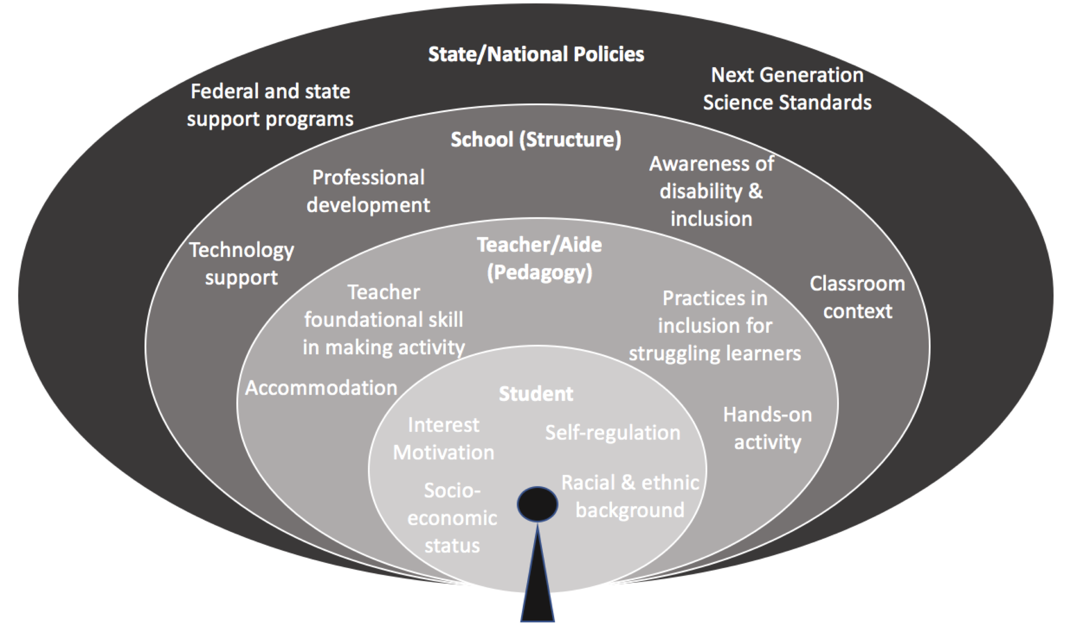
Ecological Conceptual Framework

Slide 3
Barriers to Maker Activities for Students with Disabilities

Slide 4
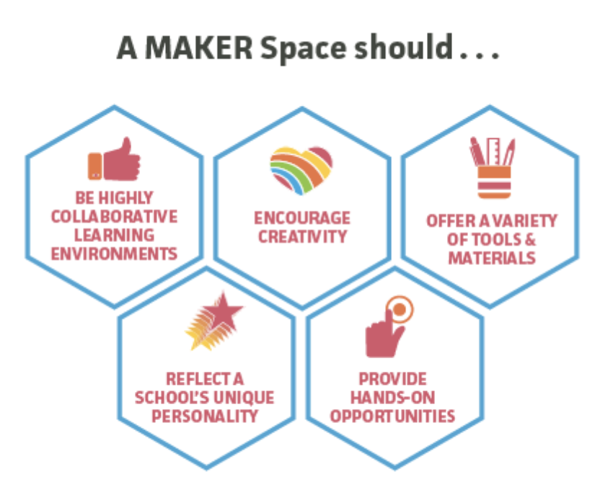
Makerspace in K-12

Slide 5
Barriers to Makerspace in K-12 Education

Slide 6
Purpose of this Study
To examine the the pedagogical and curriculum approaches by middle school teachers to include students with disabilities in makerspace instruction
Current practice
Barrier

Slide 7
Research Questions
How are students with disabilities and students at risk for academic failure participating in maker experiences?
What barriers exist for students with disabilities and those at risk for academic failure in middle schools during makerspace activities?

Slide 9
Students with Disabilities in Makerspace
Accommodations
Hands-on Experiences
Students with Disabilities
Success
Instructional Aides
Student Collaboration

Slide 10
Students with Disabilities in Makerspace
Frequent student absence
Limited persistence
Barriers
Limited Access to STEM education
Limited instructional approaches (UDL)
Structural barrier

Slide 11
What have we learned?
Teachers ability to manage behaviors within classes varied widely, affecting students’ ability to do well in maker activities
In one district, STEM class was for students NOT enrolled in music or foreign languages
Little support was given in terms of purchasing equipment or supplies. One teacher reported receiving the “hand me down” computers form other classes/programs.

Slide 12
Makerspace Professional Development Needs of Middle School Teachers

Slide 13
Makerspace Professional Development (PD) for Teachers
PD Model 1:
Makerspace experiences for teachers
(e.g., STEAM Machines™ and Engineering Design; Build a Habitat; Tooling Around with Math; The Future of Music; and Bookmaking)
(Paganelli et al., 2017)
PD Model 2:
How to facilitate and assess the maker activities
(e.g., problem-solving strategies, design-make-share, develop evaluation rubrics)
(Oliver, 2016)

Slide 14
New PD model is necessary!

Slide 15
Purpose of this Study
To examine the professional development supports for STEM teachers to help them include all students, including those with learning disabilities and at risk, in K-12 maker activities

Slide 16
Research Questions
What are the instructional supports that teachers are requesting to implement inclusive maker activities in middle school settings?; and
How do PD and coaching influence teachers’ implementation of inclusive maker activities?

Slide 17
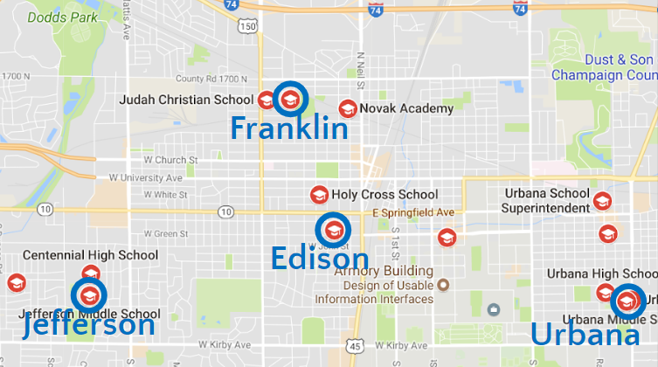
Participants
Notes:
Participants. For the current study, four participants were recruited from two school districts in a mid-sized urban community in the Midwestern United States during the 2017-2018 academic year. See Table 1.
Setting. At the time of this study, District U had 100 8th grade students in a year-long science class while District X had 180 students in grades 7-8 each quarter in technology-based STEM classes. In District X, middle schools have a quarterly rotation system which allows students to choose one among Musical Band, Foreign Language, and STEM classes.

Slide 18
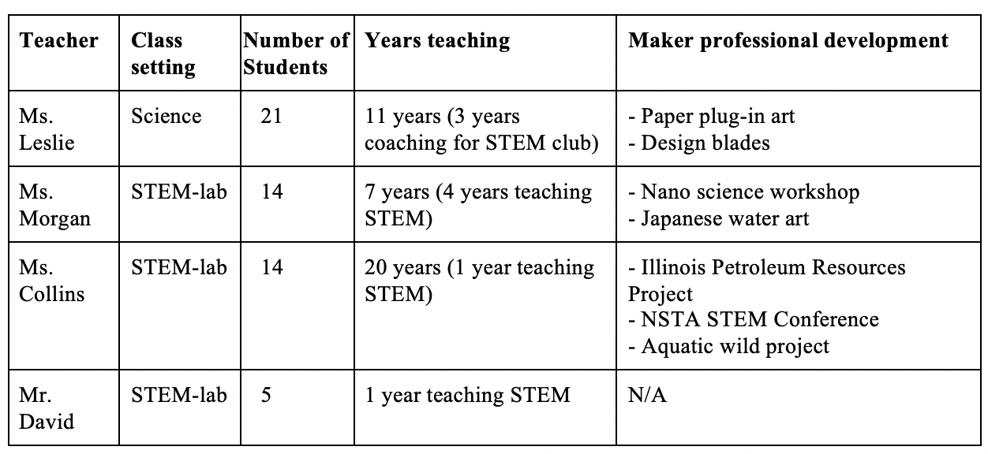
Participants (cont.)
Notes:
Participants. For the current study, four participants were recruited from two school districts in a mid-sized urban community in the Midwestern United States during the 2017-2018 academic year. See Table 1.
Setting. At the time of this study, District U had 100 8th grade students in a year-long science class while District X had 180 students in grades 7-8 each quarter in technology-based STEM classes. In District X, middle schools have a quarterly rotation system which allows students to choose one among Musical Band, Foreign Language, and STEM classes.

Slide 19
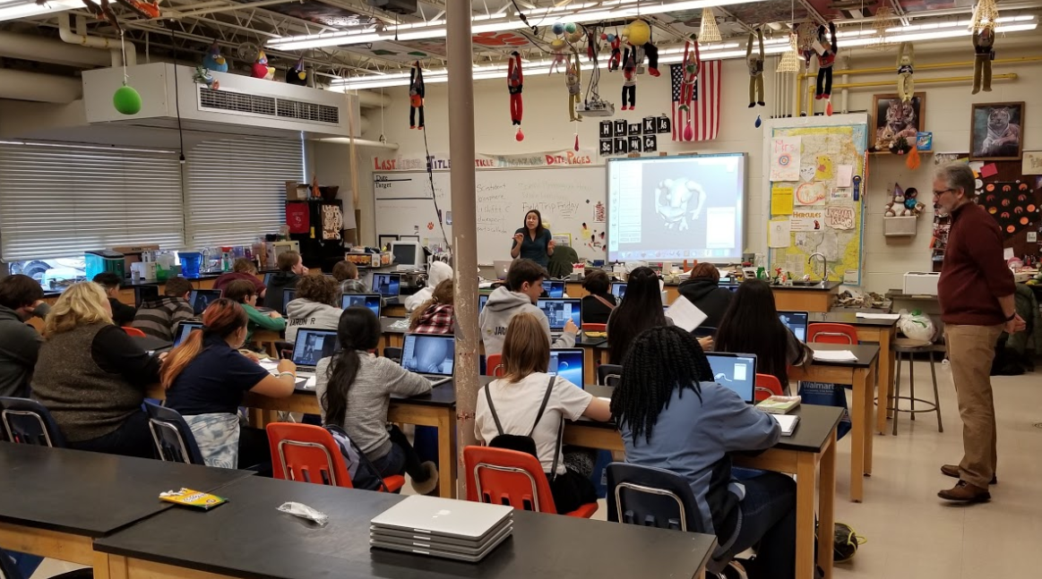
Data Collection
Data collection
Interviews
Pre-PD and Post-PD surveys
Classroom observations
Instructional materials
Notes:
This was a two-phase study. In phase one, researchers collected the data in the spring of 2018 in each of the four classrooms for 8 to 12 days of an instructional unit that include making activities. In phase two, researchers collected the data in two classrooms (e.g., Ms. Leslie and Ms. Collins) in the fall of 2018. Four types of data were collected in this study: teacher interviews, pre-PD and post-PD teacher surveys, classroom observations, and instructional materials.

Slide 20
Phase 1: Pilot maker activities
Phase 2: Teacher Professional Development
Phase 3: Embedded coaching

Slide 21
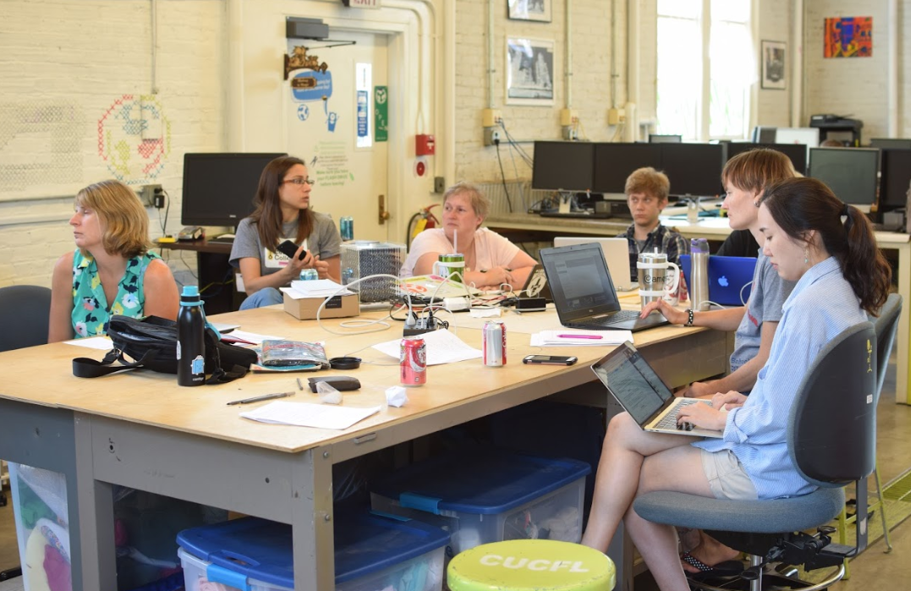
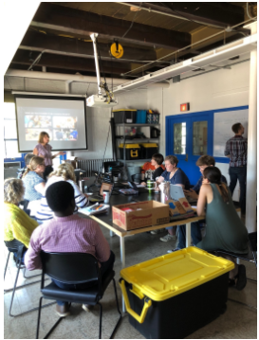
Phase 2: Teacher Summer PD
Objectives
-Sessions focused on teaching methods - defining and measuring benefits of makerspace pedagogy, promoting metacognitive learning strategies, inclusive subject matter, individual curriculum development time, etc…
-Learn-it + teach-it - go through one or more fab lab workshops to learn tools, techniques and concepts as a participant in the morning, then teach it to kids at one of our community partner sites (Urbana Neighborhood Connections Center) in the afternoon.
-Developing a plan for what equipment to buy - for your classroom/school as well as what it will take to make it sustainable.

Slide 22
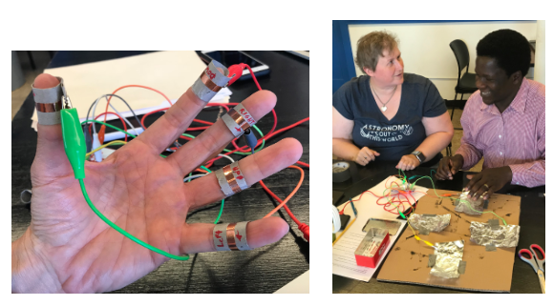
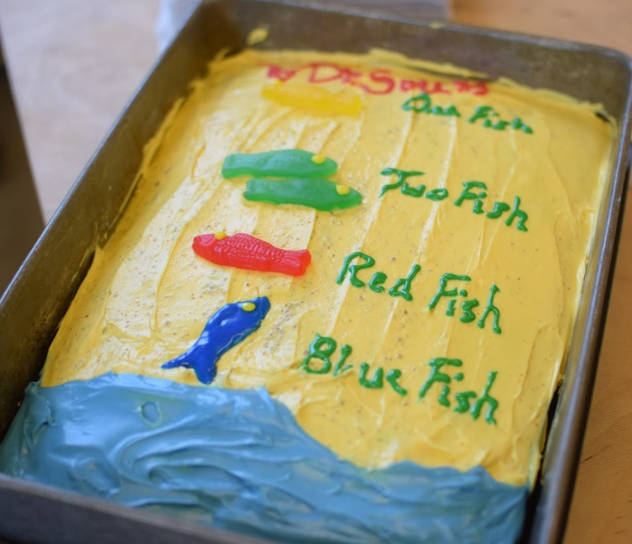
Phase 2: Teacher Summer PD
Activities
Understanding of makerspace activities
Makey-makey demonstration
Maker contents in standards/school system
Universal Design for Learning (UDL) techniques in inclusive makerspace
Positive behavior management / classroom management
Workshops

Slide 23
Results – Need for PD
Varying levels of support from administrators
Stand along technology course versus technology and content taught together
No district level PD was offered on maker activities
Very little district level PD was offered on UDL or behavior management in the classroom
Coaching could be an effective PD model to improve individual teacher practice

Slide 24
What have we learned?
Teachers have varying degrees of experience with maker activities
School administration places different value on classes with maker activities
Students do not often get a “choice” to be in classes with maker activities
Very few PD opportunities focus on maker activities, how to include students with disabilities at the district level

Slide 25
Some recommendations
Offer ongoing PD for teachers on using maker activities
Provide coaching after PD session would enhance teachers’ practices
Incorporate maker activities within a content course, rather than the stand alone “tech” course
Allow all students the opportunity to choose these classes, beyond the required 6th grade course

Slide 26
Questions?

Slide 27
Thank you.
Johnell Bentz, PhD
University of Illinois
jbentz@Illinois.edu
Chung eun Lee, PhD
Vanderbilt University
Collaborators
Jeff Ginger, PhD, University of Illinois
Maya Israel, Phd, University of Florida

